Slide 1
LaTeX
Further topics

Slide 2



House Rules
No such thing as a silly question…
… so ask me at any point…
…but I may park questions for later

Slide 3
TOC

Slide 4
Welcome to LaTeX
Introduction to the language
File and project structure
Writing commands
Formatting text
Text modifiers
Punctuation
Lists
Structuring documents
Document classes
Document sections and blocks
Writing mathematics
Simple mathematical blocks
Equations
Mathematical characters
Using figures
Using images
Image operations
LaTeX figures
Positioning figures

Slide 5
Preamble
\documentclass[papersize, fontsize]{class}
article | report | book
\title{title}
\author{author}
\date{\today}
\usepackage{setspace}
\spacing{1.6} %doublespace
% article – papers
% report – chaptered document
% book – for a book or thesis structure
%papersize: often a3paper, a4paper…
\usepackage{amsmath} %maths
\usepackage{amssymb} %maths symbols
\usepackage{graphicx}
\graphicspath{ {figures/} }
\DeclareGraphicsExtensions{.png,.pdf}
Main Body
\begin{document}
\maketitle
Typed text is as written
\textbf{bold}, \textit{italic}, \textsuperscript{s^{uper}}, \textsubscript{s_{ub}}, \textsc{SmallCaps}, \underline{ul}
` or `` to start quotes
\textendash \textemdash
tiny, scriptsize, footnotesize, small, normalsize, large, Large, LARGE, huge, Huge
\begin{flushleft} {center} {flushright}
\end{…}
\begin{itemize|enumerate|description}[A.][i.] %lettered/roman
\item bullet or numbered item
\item[label] for description item
\begin{part|chapter|abstract}
\section{name} \subsection{} \subsubsection{} \paragraph{} \subparagraph{}
\includegraphics[width|height|scale|angle|clip]{filename}
\begin{figure}[position]
\centering
\includegraphics[]{}…
\caption{caption text}
\end{figure}
\end{document}
Non-Textual
\command[options]{context}
#, $, %, ^, &, _, {, }, ~, \ are reserved
Multiple consecutive spaces = one space
2+ consecutive newlines = new paragraph
This is $inline$ maths
$$block maths$$
\begin{equation}
equation
\end{equation}
^{maths superscript}
_{maths subscript}
“\ “ – maths whitespace
\left( \left[ \left{ \right)}]…
image units: \textwidth \columnwidth mm pt cm em…
\includegraphics[clip=true, trim left bot right top]{imagepath}
\includegraphics[angle=45]{imagepath}
\setlength\fboxrule{2pt} %border thickness
\fbox{includegraphics…}
[h|t|b|p|!|H] – here, top, bottom, own page, override!, HERE!

Slide 6
Further Page Elements
Tables, Automated Meta-Sections, and additional font options

Slide 7
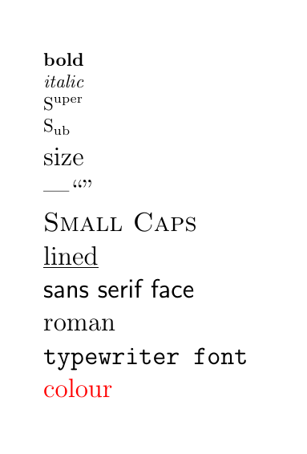
Text modifiers
\textbf{bold}
\textit{italic}
S\textsuperscript{uper}
S\textsubscript{ub}
\Large{size}
\textemdash ``”
\textsc{Small Caps}
\underline{lined}
\textsf{sans serif face}
\textrf{roman / serif face}
\texttt{typewriter font}
\textcolor{red}{colour}

Slide 8
Colours
Color
XColor
\usepackage{color}
Basic colors:
Red, blue, green, white, black, yellow, cyan , magenta…
Simple Web and print-safe options
\usepackage[dvipnames]{xcolor}
Wider range of colour options
All generally print-safe
Usually the standard package used for colours
Calls the DVIP driver colour names

Slide 9
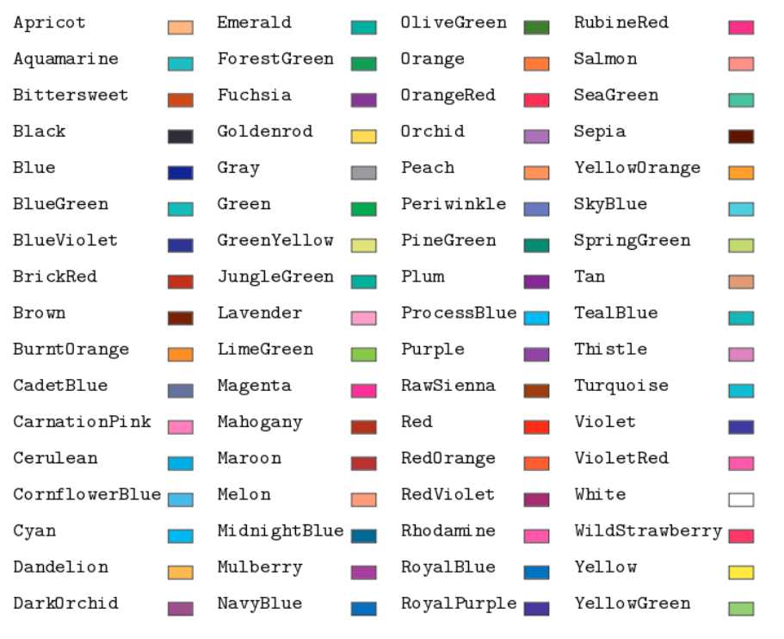
Xcolor DVIP colours

Slide 10
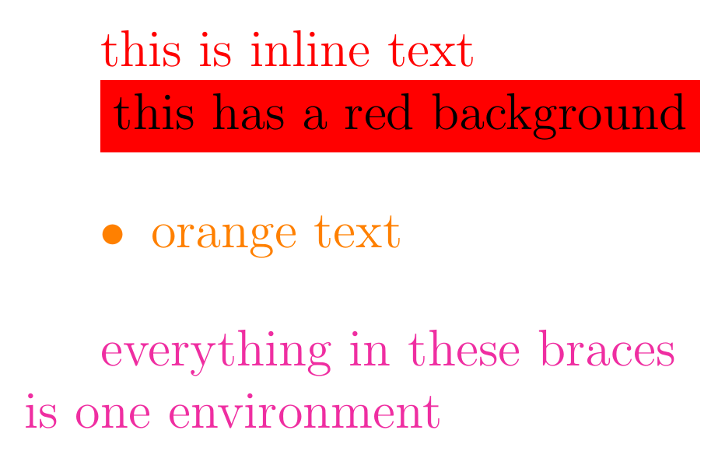
Using colour
\textcolor{red}{this is inline text}
\colorbox{red}{this has a red background}
Any environment can set its text colour with:
\begin{itemize}
\color{orange}
\item orange text
\end{itemize}
{\color{Rhodamine} everything in these braces\\ is one environment}

Slide 11
Making your own colours
Faded colours:
\textcolor{Cerulean!50}{50\% white}
Mixed colours:
\textcolor{Creulean!50!Magenta}{50\% Magenta}
Defined colours:
\definecolor{name}{rgb|RGB|cmyk|grey}{values} % preamble
\textcolor{name}{text}

Slide 12
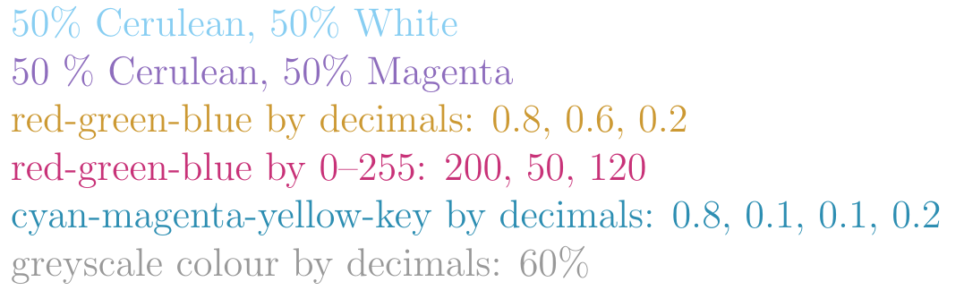
Exercise: colours
Emulate this:

Slide 13
Exercise: colours
\definecolor{rgb_colour1}{rgb}{0.8, 0.6, 0.2}
\definecolor{rgb_colour2}{RGB}{200, 50, 120}
\definecolor{cmyk_colour}{cmyk}{0.8, 0.1, 0.1, 0.2}
\definecolor{greyscale}{gray}{0.6}

Slide 14
Exercise: colours
\textcolor{Cerulean!50}{50\% Cerulean, 50\% White}
\textcolor{Cerulean!50!Magenta}{50 \% Cerulean, 50\% Magenta}
\textcolor{rgb_colour1}{red-green-blue by decimals: 0.8, 0.6, 0.2}
\textcolor{rgb_colour2}{red-green-blue by 0\textendash 255: 200, 50, 120}
\textcolor{cmyk_colour}{cyan-magenta-yellow-key by decimals: 0.8, 0.1, 0.1, 0.2}
\textcolor{greyscale}{greyscale colour by decimals: 60\%}

Slide 15
Fonts
Serif fonts
Contain details and tails to letters (serifs)
Helpful for reading printed material
Sans-Serif fonts
Contain no serifs
Typically better for screen-viewing
Typewriter fonts
Typically monospaced
Good for emphasis and ensuring every character is fully legible – e.g. code

Slide 16
Additional fonts
Default family of LaTeX fonts are the “Computer Modern” fonts
Loaded as packages in the preamble
\usepackage{fontfamilyname}
Can be switched to in the body:
{\fontfamily{font-code}\selectfont …text…}
Not all fonts are supported
See https://tug.org/FontCatalogue/

Slide 17
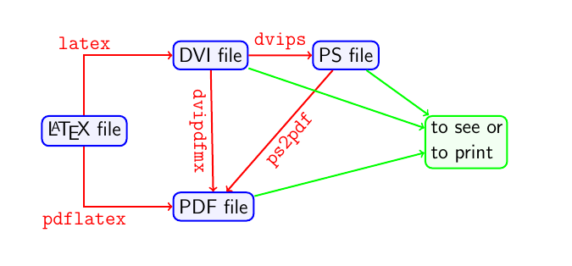
A detour on compilers
The base compiler is TeX
Additional variants exist for further functionality in image and font support and document rendering

Slide 18





Compilers?
Additional resources
.tex document
Output document
LaTeX
TeX engine

Slide 19

Compilers?
Additional resources
.tex document
Output document
LaTeX
Document parsing
TeX engine

Slide 20

Compilers?
Additional resources
.tex document
Output document
LaTeX
Document parsing
TeX engine
Primitive TeX

Slide 21

Compilers?
Additional resources
.tex document
Output document
LaTeX
Document parsing
TeX engine
Primitive TeX
Skeleton

Slide 22
Compilers?
Additional resources
.tex document
Output document
LaTeX
Document parsing
TeX engine
Primitive TeX
Skeleton

Slide 23
Compilers?
Additional resources
.tex document
Output document
LaTeX
Document parsing
TeX engine
Primitive TeX
Skeleton

Slide 24
A detour on compilers
The base TeX compiler is LaTeX
Additional variants exist for further functionality in image and font support and document rendering

Slide 25
TeX Variants
pdfLaTeX
A extension to TeX that renders documents as pdfs before display
The default compiler for LaTeX as it provides better image support that bare TeX
XeTeX / XeLaTeX
eXtensible TeX / LaTeX
Support all core image types
Extended package support and wider font support
LuaLaTeX
Similar to XeLaTeX in extensibility, allows advanced control of document creation with Lua

Slide 26
XeLaTeX
Not standard on Overleaf but can be enabled
Provides strong support for non-Latin alphabets
Standard for complex typographic documents
Beyond the scope of this series, but well documented

Slide 27
Standard typographic packages
Babel
used for international language support
\usepackage[english]{babel}
\usepackage[ancientgreek, farsi]{babel}
Inputenc
used to specify the encoding of the document – how the computer saves characters on a bit-wise level.
Modern computing (and XeLaTeX) uses UTF8, but LaTeX doesn’t use it as standard. Helpful to explicitly set.
\usepackage[utf8]{inputenc}

Slide 28
Labelling
Provides a way to reference sections and elements in your document
Allows smart referencing
Provides meta-information to LaTeX for auto-generated sections

Slide 29
Labels in your document
\label{your label text}
Can be placed inside a figure, equation or other element
\begin{figure} \label{myfigurelabel} … \end{figure}
Can be placed next to a document structure statement
\section{sectionname} \label{mysectionlabel}

Slide 30
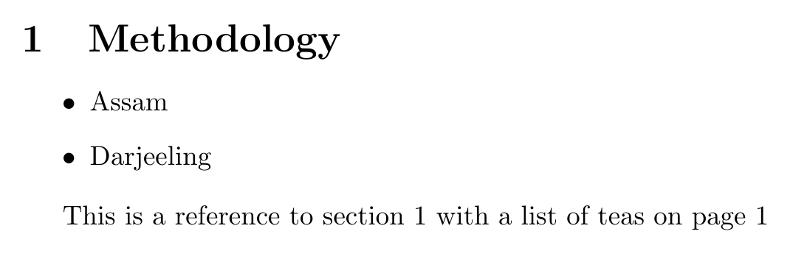
Labels in practice
\section{Methodology}
\label{section: methodology}
\begin{itemize}
\label{list: teas}
\item Assam
\item Darjeeling
\end{itemize}
This is a reference to section \ref{section: methodology} with a list of teas on page \pageref{list: teas}

Slide 31
Automated Meta-sections
Tables of contents
Lists of figures
Lists of tables
Bibliographies
Glossaries
Indexes
Nomenclatures

Slide 32
Table of Contents
\renewcommand*\contentsname{summary} %preamble
\tableofcontents
\section{this appears in the TOC}
\addcontentsline{toc}{section}{a section title}
\section*{this doesn’t, and isn’t numbered}

Slide 33
List of figures or tables
\renewcommand{\listfigurename}{List of plots}
\renewcommand{\listtablename}{Tables}
\listoffigures
\listoftables
Note: Your figures MUST have a caption to appear or be referenced anywhere, as the caption generates the fig or table number, and to have text that appears in the list.

Slide 34
Tables
Defined by the tabular environment
Automatically align and shift spacing to best display the information in the cells
Can be slow and tedious
Consider using a generator online for larger tables
Alignment uses the & character

Slide 35
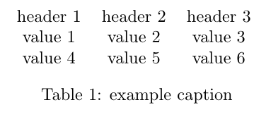
Tables in LaTeX
\begin{table}[h!]
\centering
\begin{tabular}{c c c}
header 1 & header 2 & header 3 \\
value 1 & value 2 & value 3 \\
value 4 & value 5 & value 6
\end{tabular}
\label{table: example}
\caption{example caption}
\end{table}

Slide 36
Styling columns
\begin{tabular}{c c c}
The {c c c} defines the justification and style of the columns:
{ |c|c|c| } gives single vertically lined columns of centred text.
{ |l|c|r| } gives a left-, centre- and right-justified column, respectively
{ |c || c | c |} gives a double line between the 1st and 2nd columns

Slide 37
Styling rows
Horizontal lines can be created using \hline between your rows of cells
Like columns you can create double lines. Use the command twice to achieve this.
To add colours, use the xcolors package again.
\usepackage[dvipsnames, table]{xcolor} %preamble
{\rowcolors{starting row}{colour1}{colour2}
\begin{table}…

Slide 38
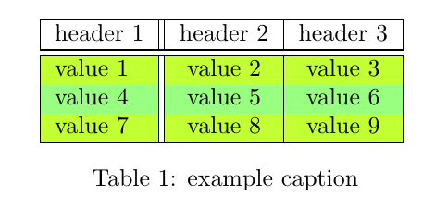
Table style in practice
\documentclass{article}
\usepackage[dvipsnames, table]{xcolor}
\begin{document}
{\rowcolors{2}{green!80!yellow!50}{green!30!yellow!80}
\begin{table}[h!]
\centering
\begin{tabular}{|l || c | c |}
\hline
header 1 & header 2 & header 3 \\
\hline \hline
value 1 & value 2 & value 3 \\
value 4 & value 5 & value 6 \\
value 7 & value 8 & value 9 \\
\hline
\end{tabular}
\label{table: example}
\caption{example caption}
\end{table}
\end{document}

Slide 39
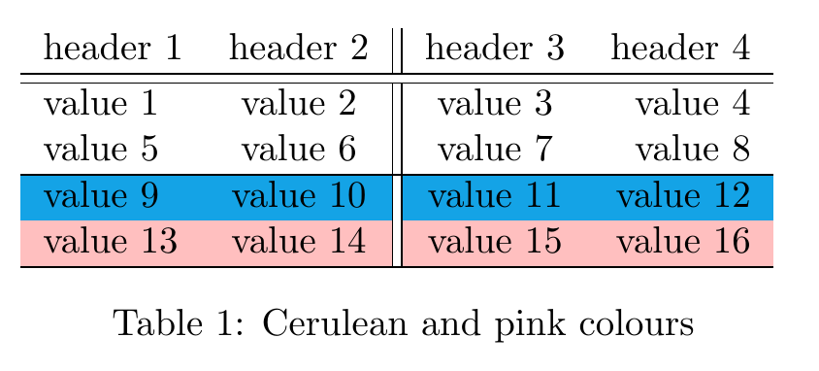
Exercise: tables

Slide 40
Exercise: tables
\documentclass{article}
\usepackage[dvipsnames, table]{xcolor}
\begin{document}
{\rowcolors{4}{pink}{Cerulean}
\begin{table}[h!]
\centering
\begin{tabular}{l c || c r}
header 1 & header 2 & header 3 & header 4\\
\hline \hline
value 1 & value 2 & value 3 & value 4 \\
value 5 & value 6 & value 7 & value 8 \\
\hline
value 9 & value 10 & value 11 & value 12 \\
value 13 & value 14 & value 15 & value 16 \\
\hline
\end{tabular}
\label{table: example}
\caption{Cerulean and pink colours}
\end{table}
\end{document}

Slide 41
More on tables
Much more can be achieved with tables in LaTeX:
Advanced colouring rules
merged columns
multipage tables
fixed-width column sizes
and more
Requires additional packages (tabularx, tabu, array)

Slide 42
Document layout
Document structure, layouts, multifile documents, headers and footers, columns, and spacings

Slide 43
Multi-file documents
To see even minor changes to a document, the .tex file needs to be recompiled and re-rendered.
For smaller articles, this is a trivial task, but as the document grows and more tables, images and reference links are added, the compute time grows exponentially
For larger documents, it is often better (and safer) to split parts away to separate .tex files.

Slide 44
Two commands to adding .tex files
Input
Include
\input{filename.tex}
Formats according to the base file preamble
Can be nested, with inputs to other files in the imported file
Can be imported inline
\include{filename}
Formats according to the base file preamble
Cannot be nested, but can include files with their own inputs
Forces a page break

Slide 45
Two packages to splitting files
Subfiles
Standalone
\usepackage{subfiles} \subfile{filename}
Uses the main document’s preamble
Child documents start with: \documentclass[main.tex]{subfiles}
All preamble statements occur in the main document
\usepackage{standalone} \input | \include
Uses each child’s preamble
Child documents start with: \documentclass{standalone}
Each chapter’s preamble is self-contained and isolated

Slide 46
Hierarchy of a LaTeX project
Main Directory
Main .TeX file
Chapter directories
Chapter .TeX files
Figures
Images
.bibtex
Generated .pdf
Figures
Bibliography

Slide 47
Line breaks and blank spaces
Multiple ways to add vertical negative spaces to your document. To break a line you can use:
Newline-newline creates a new paragraph
\\ creates an inline line-break, with no indentation.
\newline is a more explicit version of \\ for text
\hfill \break fills the rest of the line with space, and break adds a new line.

Slide 48
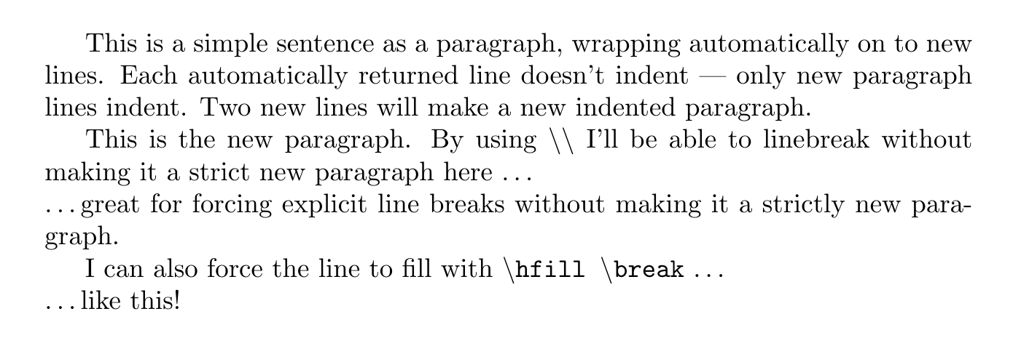
Exercise

Slide 49
Exercise
This is a simple sentence as a paragraph, wrapping automatically on to new lines. Each automatically returned line doesn't indent \textemdash \ only new paragraph lines indent. Two new lines will make a new indented paragraph.
This is the new paragraph. By using \textbackslash \textbackslash \ I'll be able to linebreak without making it a strict new paragraph here \textellipsis \\ \textellipsis great for forcing explicit line breaks without making it a strictly new paragraph.
I can also force the line to fill with \texttt{\textbackslash hfill \textbackslash break} \textellipsis \hfill \break \textellipsis like this!

Slide 50
Page breaks
Breaking a page is simple: There are two ways to explicitly make a new page:
\clearpage makes a new page at that position in the text. Importantly, if there any floating elements (e.g. figures) prior to the break, LaTeX displays them before the break.
\newpage makes a new page at that position in the text, but does not interfere with where LaTeX places any floating elements

Slide 51
Paragraph styles
The indentation and the gap between paragraphs can be set in the preamble with:
\setlength{\parindent}{4em}
\setlength{\parskip}{1em}
The text can be stretched horizontally with:
\renewcommand{\baselinestretch}{1.5}

Slide 52
Other spaces
Horizontal spaces:
\hspace{size} makes a measured blank along a line
\hfill fills as much of the row as it can
Vertical spaces:
\vspace{size} makes a measured blank down a page
\vfill fills as much of the vertical page as it can
\smallskip makes a ~3pt vertical gap
\medskip makes a ~6pt vertical gap
\bigskip makes a ~12pt vertical gap

Slide 53
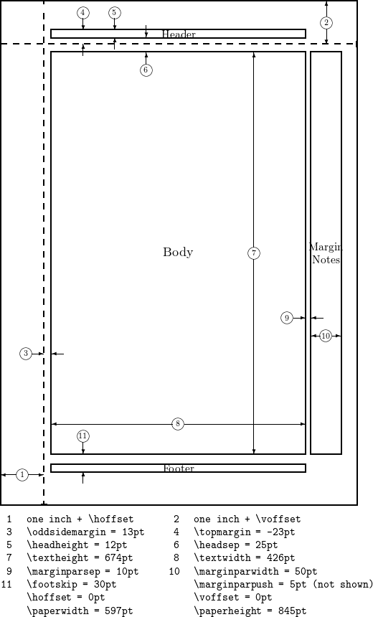
Page geometry
Padding
Margins
Text area
Paper size
Orientation
Footers and Headers

Slide 54
\usepackage{geometry}
Allows broad tuning of the default page layout:
\geometry{options} %preamble
papersize and orientation: [a4paper, landscape]
Margin and body size: [margin=2cm, total={10cm, 14cm}]
Headers and footers: [top=5cm, bottom=4cm]
Left and right margin: [left=4cm, right=2cm]

Slide 55
Page sizes
a0paper – a6paper,
b0paper – b6paper,
c0paper – c6paper,
b0j – b6j
ansiapaper - ansiepaper,
letterpaper, executivepaper, legalpaper

Slide 56

A series paper
ISO standard based on the aspect ratio of a 1 : $\sqrt{2}$
Each size down is half the area, and can be made by folding the paper in half
Standard usage everywhere except the US and Canada
Some central American countries use A paper as standard but commonly also use US paper sizes

Slide 57

B series paper
ISO standard based on the aspect ratio of a 1 : $\sqrt{2}$
Sits between A series paper: B0 is exactly between A0 and A1
Each size down is half the area, and can be made by folding the paper in half
Often used for poster sizes, books, envelopes, passports
Can work as a go-between for fitting scaled US and A series paper in one document

Slide 58

C series paper
ISO standard based on the aspect ratio of a 1 : $\sqrt{2}$
Averaged size of A and B sizes of the same rank: C0 is halfway between A0 and B0
Each size down is half the area, and can be made by folding the paper in half
Usually used for envelopes: A4 fits inside a C4, and A4 and C4 fit inside B4.

Slide 59
Japanese B series variant
Japanese alternative to the B series (e.g. b0j)
Typically 1.5x larger than the corresponding area of the A paper
Each size down is half the area, and can be made by folding the paper in half

Slide 60

US Sizes
Standard in the US, and the de-facto standard in Canada and some Central American countries.
Letter paper: length is “$\frac{1}{4}$the average maximum stretch of an experienced vatman's arms.” Shorter and fatter than A4.
Legal paper: Same width and longer than letter paper
Ledger (executive) paper: Smaller and thinner than A4.
Paper | Dimensions (inches)
A4 | 8.27 x 11.7
Letter | 8.5 x 11
Legal | 8.5 x 14
Executive | 7 x 10

Slide 61
Emperor (1.219m x 1.829m)
42” x 72” | 121.9cm x 182.9cm
Quad Demy
Antiquarian
Grand Eagle
Double Elephant
Atlas
Colombier
Double demy
Imperial
Double large post
Name | Folds | Leaves
Folio | 1 | 2
Quarto | 2 | 4
Sexto | 3 | 6
Octavo | 3 | 8
Duodecimo | 4 | 12
Sextodecimo | 4 | 16
Elephant
Princess
Cartridge
Royal
Sheet
Double Post
Super Royal
Broadsheet
Medium
Demy
Copydraught
Large Post
Post
Crown
Pinched Post
Foolscap
Small Foolscap
12.5” x 15” | 31.8cm x 38.1cm
Brief
Pott

Slide 62
Two sided documents
Sometimes your documents will be printed in a bound or other book format. This means that left and right sides of the page are now different in layout.
Typically, you’ll want the margin nearer to the spine to be larger.
Use \documentclass[twoside]{…}
Geometry also offers binding settings for two-sided documents for finer tuning, if necessary.

Slide 63
Headers and Footers
LaTeX has some pre-defined headers and footers for ease of use, with \pagestyle{option}:
{headings} number and section in header, in footer on new chapter pages
{plain} number in footer
{myheadings} number in header
Setting the style to only the current page can be achieved with \thispagestyle{}. A style can be cleared with {empty}
Works with two-paged documents

Slide 64
Fancyheader – one sided docs
\usepackage{fancyhdr}
\pagestyle{fancy}
\fancyhf{} % clears the standard header
\rhead{\thepage}
\chead{}
\lhead{}
\rfoot{}…

Slide 65
Fancyheader – two sided docs
\usepackage{fancyhdr}
\pagestyle{fancy}
\fancyhf{} % clears the standard header
\fancyhead[LE, RO]{\thepage}
\fancyhead[CE, CO]{Example header}
\fancyfoot[RO]{Example footer}…

Slide 66
\Fancyhead[positioning]
Fancyhead and fancyfoot place headers and footers differently on different pages:
 | Left | Centre | Right
Even | LE | CE | RE
Odd | LO | CO | RO

Slide 67
Autogenerated Information
\thepage – the page number
\thechapter – the chapter number
\thesection – the section number
\chaptername – “Chapter” or translated equivalent
\leftmark – Name and number of the current top level structure (Chapter or Section)
\rightmark – Name and number of the current second level structure (Section or SubSection)

Slide 68
Page numbering
Default style is numbered, but can be set with \pagenumbering{option} in the preamble
Options include:
arabic – arabic numbering (default): 1, 2, 3, 4, 5
roman – lowercase numerals: i, ii, iii, iv, v,
Roman – uppercase numerals: I, II, III, IV, V
alph – lowercase letters: a, b, c, d, e,
Alph – uppercase letters: A, B, C, D, E

Slide 69
Frontmatter and Mainmatter
In books, the foreword is typically in page-numbered in numerals, and the main body is page-numbered in Arabic numbers.
Book documents have an automatic solution to this.
\frontmatter and \mainmatter automatically handle the changing styles for you.
Place \frontmatter at the beginning of the document main body, and \mainmatter where the foreword ends.

Slide 70
Columns
The multicols package provides the easiest and perhaps prettiest out-of-the box columns.
\usepackage{multicols} %preamble
\begin{multicols}{number of columns}
[header text here]
text…
\end{multicols}

Slide 71
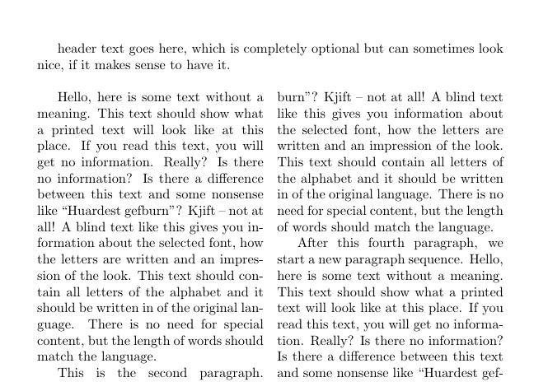
Column headers

Slide 72
Exercise
\documentclass[twoside]{book}
\title{Example fancyhdr document}
\author{A\`{u} Th\o r}
\usepackage{blindtext}
\begin{document}
\maketitle
\chapter{foreword}
\section{Acknowledgements}
\Blindtext
\section{Greetings}
\Blindtext
\tableofcontents
\Blinddocument
\end{document}
Check the day 2 #08 pdf on GitHub
You’ll need to add:
Columns
Footers and Headers
Front and Main Matter

Slide 73
Exercise
\documentclass[twoside]{book}
\title{Example fancyhdr document}
\author{A\`{u} Th\o r}
\usepackage{fancyhdr}
\pagestyle{fancy}
\fancyhf{}
\fancyhead[CO]{\rightmark}
\fancyhead[CE]{\leftmark}
\fancyfoot[RO, LE]{Page: \thepage}
\usepackage{multicol}
\usepackage{blindtext}
\begin{document}
\frontmatter
\maketitle
\chapter{foreword}
\section{Acknowledgements}
\Blindtext
\section{Greetings}
\begin{multicols}{2}
[This is the multicol columns header for the Greetings section.]
\Blindtext
\end{multicols}
\tableofcontents
\mainmatter
\Blinddocument
\end{document}

Slide 74
Bibliographies
How to use bibtex, how to cite and how to autogenerate bibiliographies.

Slide 75
Citations in LaTeX
Two part process: Importing a bibliography and in-body citation.
Requires a backend file that describes your references: a bibtex file
Requires a frontend package for managing your ctations and references: biblatex is common, but natbib is more customisable and better for worded citations instead of numeric citations.
You will need to bring your bibtex file into your tex file’s folder

Slide 76
Bibliography boilerplate
%preamble
\usepackage{natbib}
\bibliographystyle{“style”}
%main body
\citep{key}
\bibliography{example} %path to bibliography

Slide 77
.bib files
Bibtex/biblatex files can be written by hand, but are easiest generated from any reference manager.
Contains highly structured metadata and data on the body of literature referenced
Can contain entire folders of papers, not just the individual ones cited.

Slide 78
Citation
Multiple ways to cite a paper, but all use the “key” of the citation. Your reference manager may tell you this, or you can search it in the file. This is the unique reference to the paper you’re citing:
\citet{key}: textual citation. E.g. “Strange et. al. (2019)”
\citep{key}: parenthetical citation: E.g. “(Strange et. al. 2019)”
\citeauthor{key}: E.g. “Strange et. al.”
\citeyear{key}: E.g. “(2019)”
If you use citet*{} or citep*{} natbib will print all authors instead of et. al.

Slide 79
Citation styles
Your citations are completely customisable. In the preamble, set your pattern with:
\setcitestyle{citation mode, sep, options}
Citation mode: authoryear|numbers|super
Brackets: round|square OR open={char}, close={char}
Separator: semicolon|comma

Slide 80
Bibliography style
Multiple styles available: full documentation here http://mirrors.ibiblio.org/CTAN/macros/latex/contrib/natbib/natbib.pdf
Bibliography styles can be specified in the preamble with \bibliographystyle{abbrvnat}
Common styles include abbrvnat, plainnat and unsrtnat

Slide 81
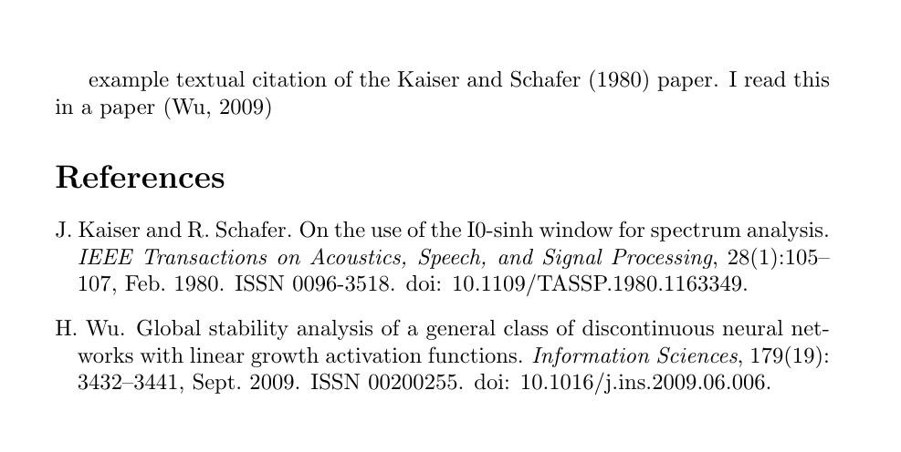
Example file
\documentclass{article}
\usepackage{natbib}
\bibliographystyle{abbrvnat}
\setcitestyle{authoryear, round}
\begin{document}
example textual citation of the \citet{KaiseruseI0sinhwindow1980} paper. I read this in a paper \citep{WuGlobalstabilityanalysis2009}
\bibliography{specimen_bibliography}
\end{document}

Slide 82

Good luck!

